Slide 1

WEB DEVELOPMENT AT DIGITAL HUB SOLUTION LTD
PRESENTED BY:
Fatima Noor Popy
ID:161014005
Department: CSE
University of Liberal Arts Bangladesh
SUPERVISED BY:
Abul Kalam Al Azad,PHD
Associate Professor
Computer Science and Engineering
University of Liberal Arts Bangladesh

Slide 2

GENERAL INFORMATIOM OF DIGITAL HUB SOLUTION LTD
Name: Digital Hub solution Ltd
Address:House-8,Road-4/A,Dhanmondi,Dhaka
Company website: www.digitalhubltd.com
Year of Establishment: 2015
Email: saied@digitalhubltd.com
Contact No: 01750375327

Slide 3
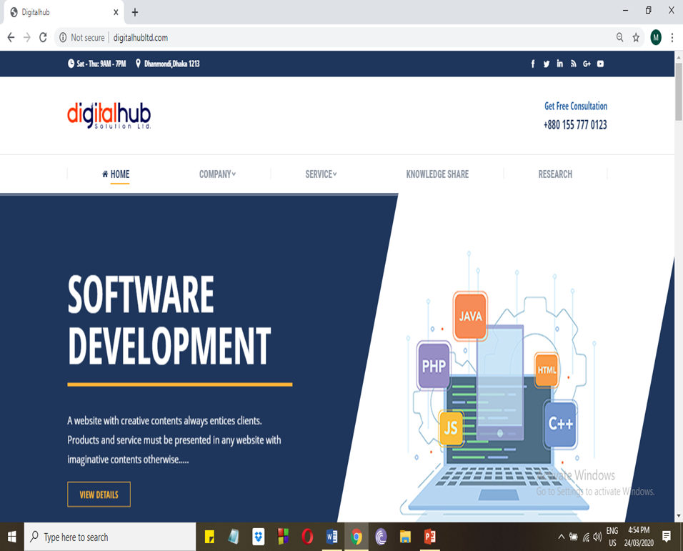
WHAT DIGITAL HUB SOLUTION LTD DO
Digital Hub Solution Ltd mainly focus on Web development and software development .
.Digital Hub provided
Website Design and development.
Software Development.
Graphic Design and service.
E-Commerce service.

Slide 4

MY RESPONSIBILITIES AT DIGITAL HUB SOLUTION LTD
Web Development
Logo design
Content writer

Slide 5

PROJECT REQUIREMENT AND NAME
Project Name: E-learning Management System
Requirement:
Through this software students could learn and buy course from online.
Students- Choose course, make payment, give exam, discount, certificate, job offer, contact.
Teachers- Manage exam, Manage score, Took class, Contact.
Admin- Approve
Login, Logout, Register, Search Materials

Slide 6

TOOLS USED ON PROGRAMMING LANGUAGE
FONT-END
CSS3
XML
J-QUERY
HTML5
JAVA SCRIPT
BOOTSTRAP4
SERVER: Web Server

Slide 7





TOOLS USED ON PROGRAMMING LANGUAGE
BACK-END

Slide 8
MODEL USED ON PROJECT
Incremental Process Model
Agile Process Model
V Process Model

Slide 9
INCREMENTAL PROCESS MODEL

Slide 10
AGILE PROCESS MODEL

Slide 11
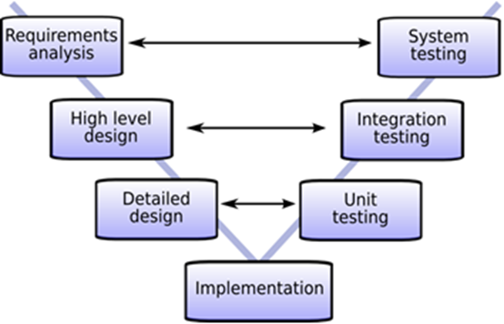
V PROCESS MODEL

Slide 12
Flow CHART

Slide 13
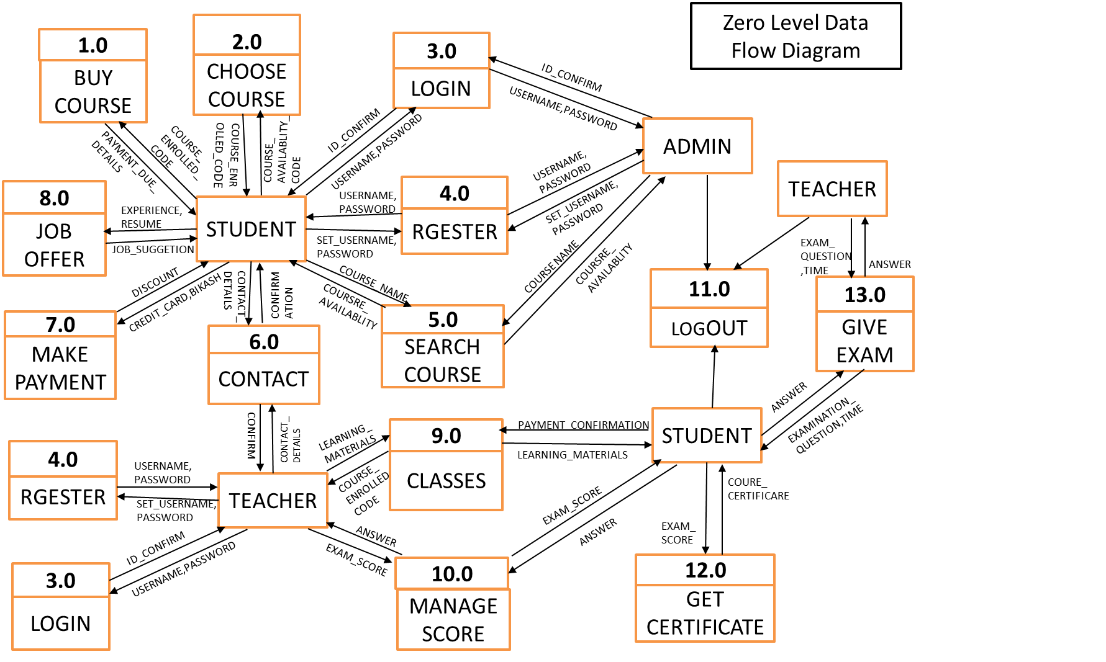

Slide 14
Use case Diagram

Slide 15
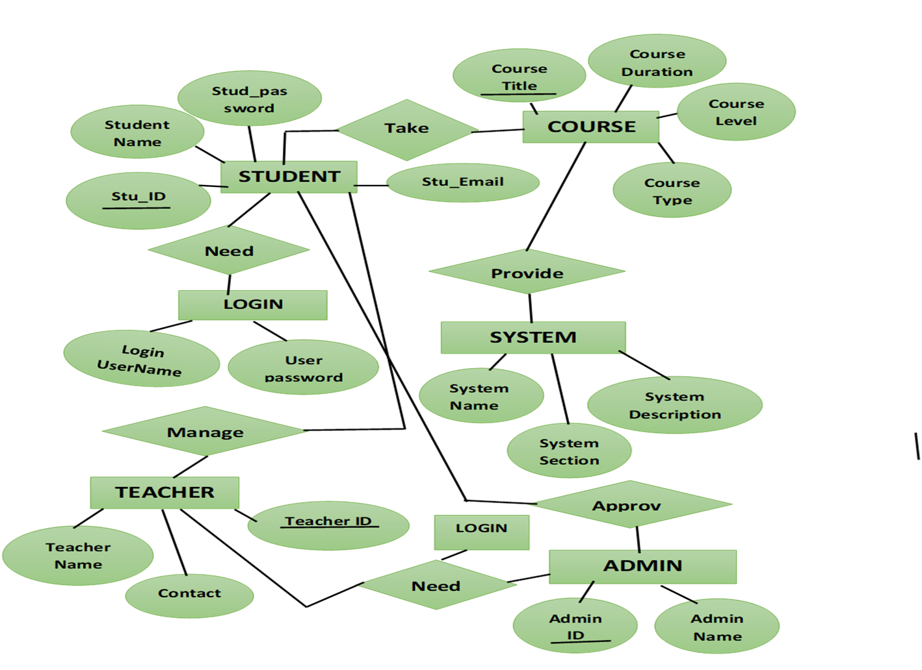
ER Diagram

Slide 16

HOME PAGE OF E-LEARNING MANAGEMENT SYSTEM

Slide 17

COURSE INTERFACE

Slide 18
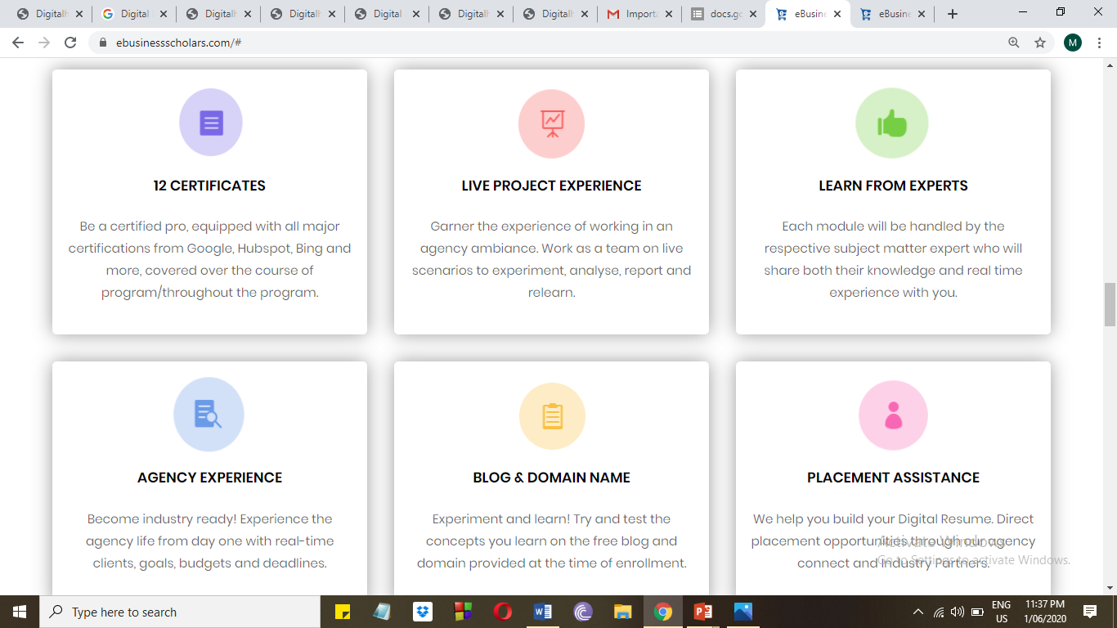
WEBSITE FEATURE

Slide 19
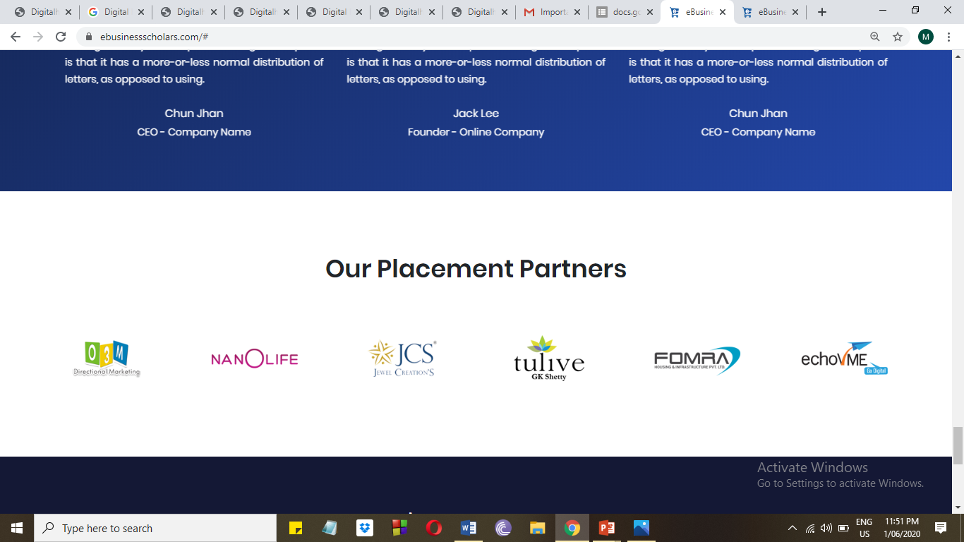
JOB SEARCH

Slide 20
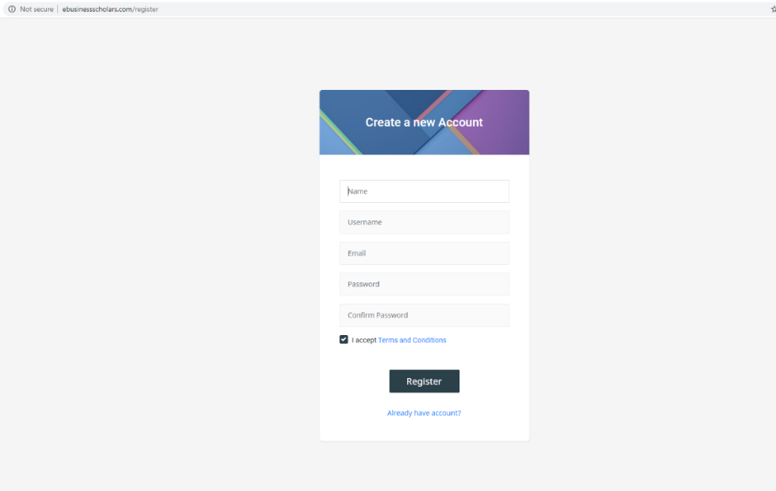
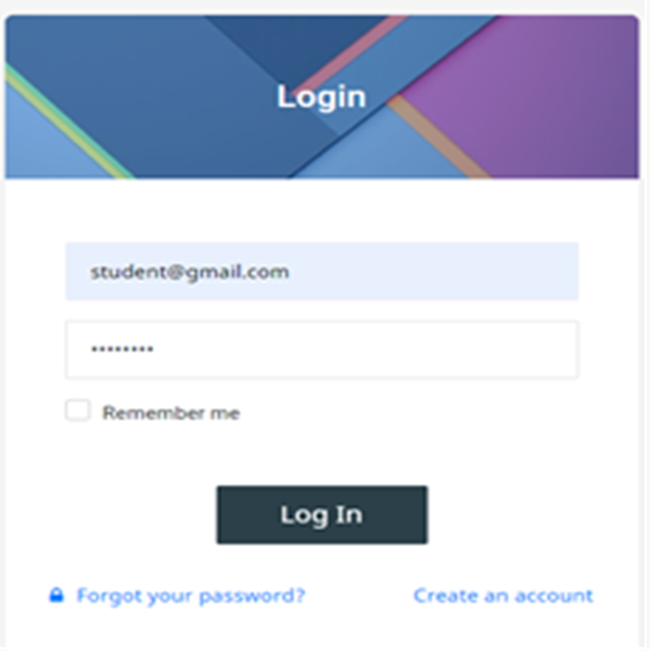
REGESTRATION AND LOGIN PAGE

Slide 21
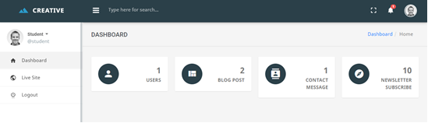
STUDENT PAGE

Slide 22
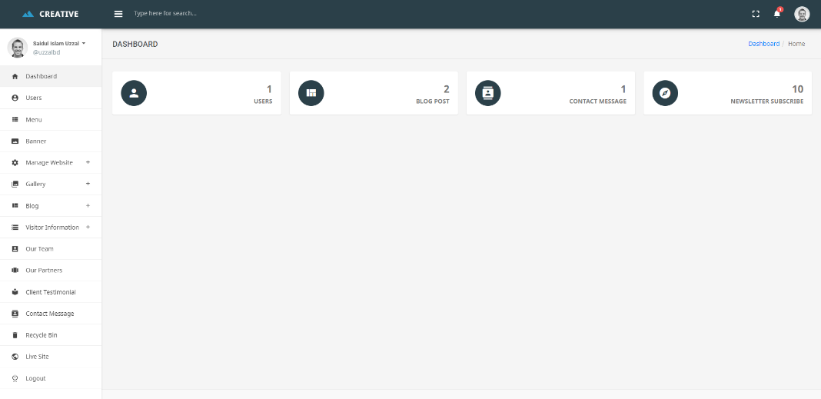
ADMIN PAGE

Slide 23

Project (2) Ekusheyboimela
Designing Logo

Slide 24
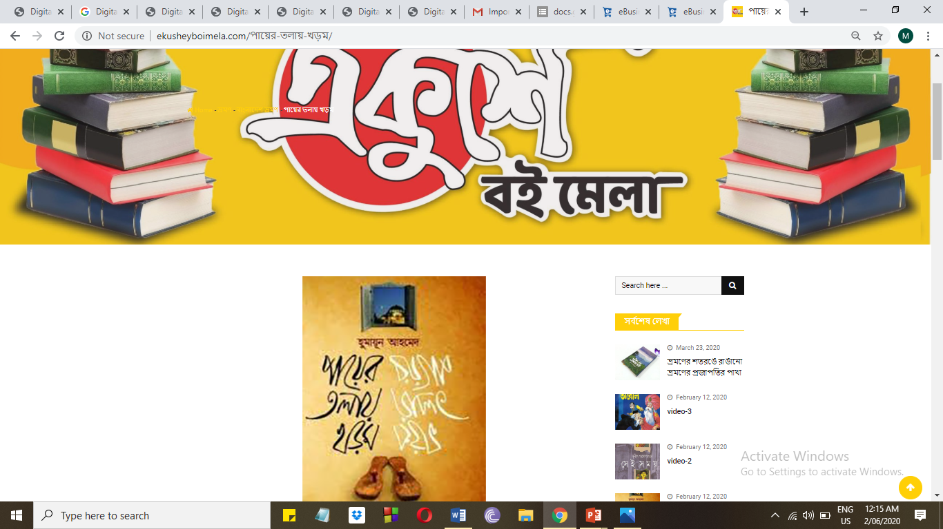
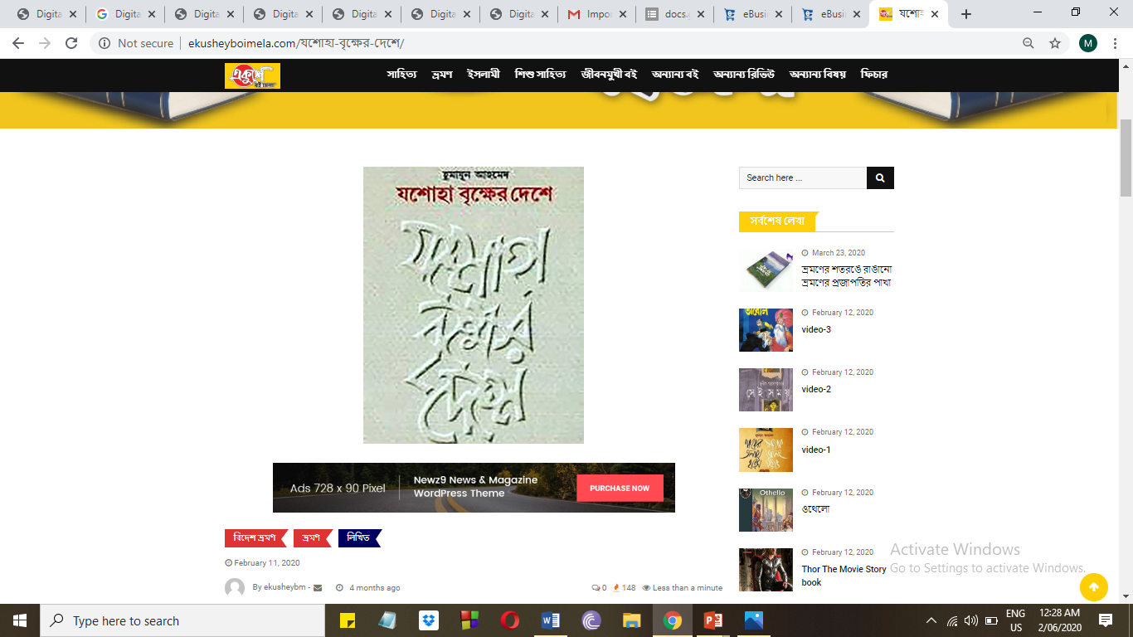
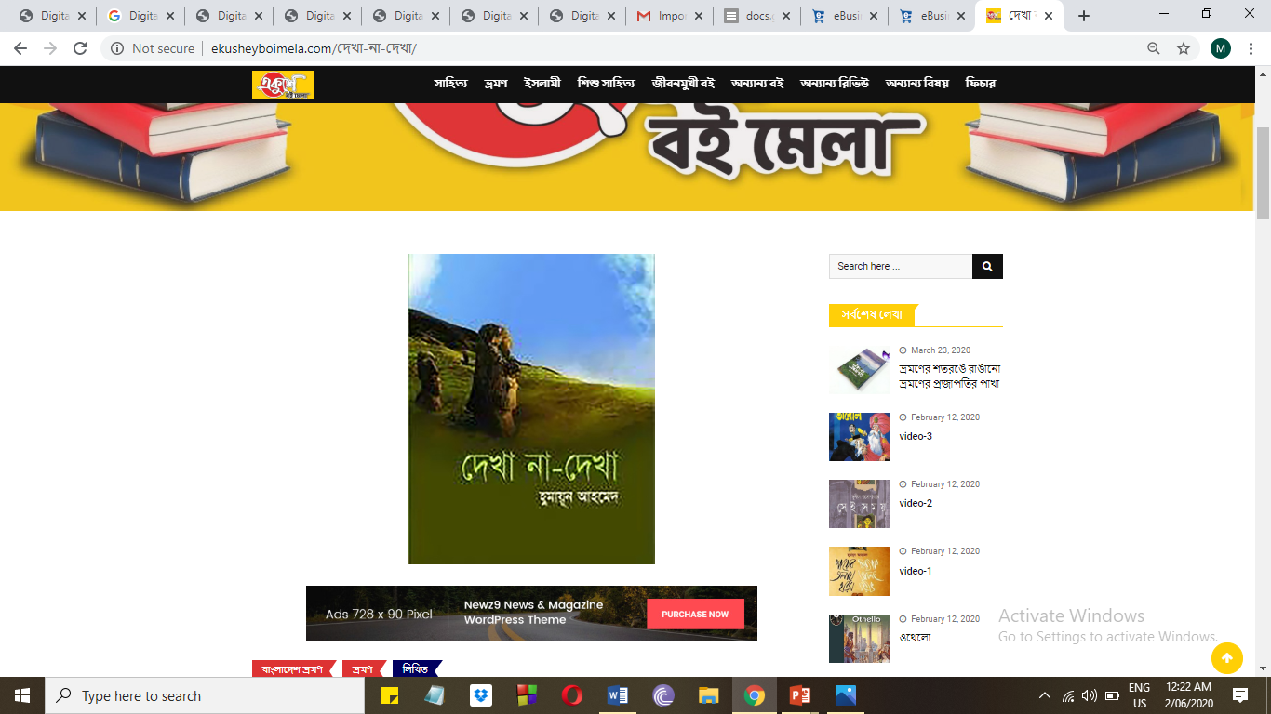
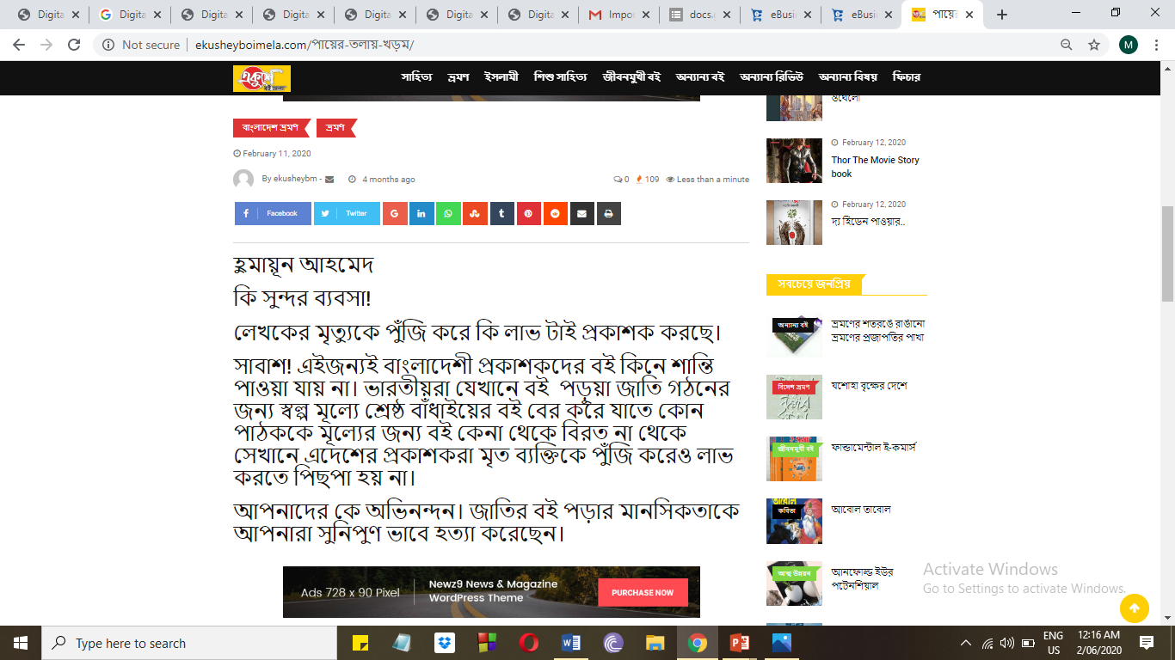
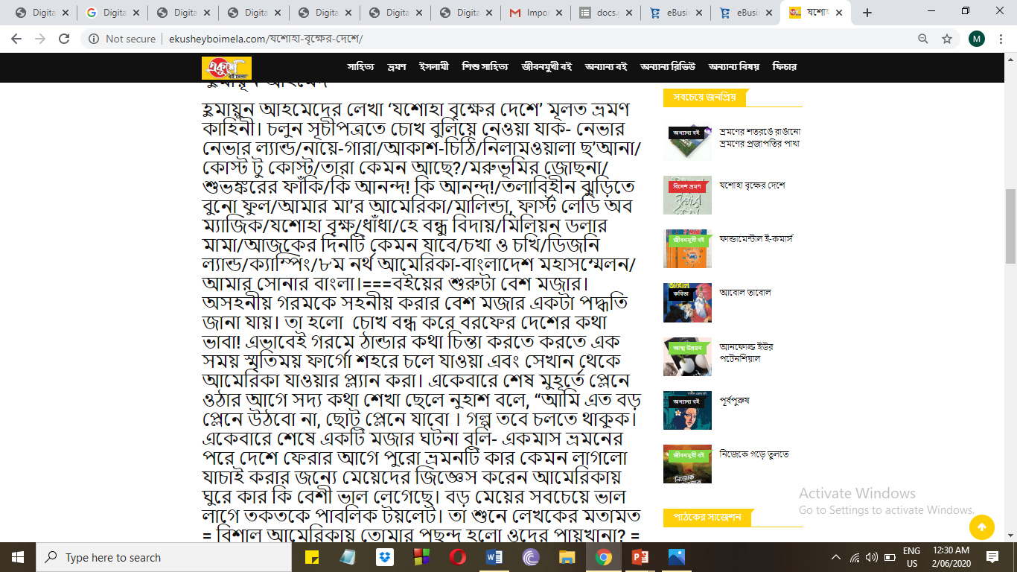
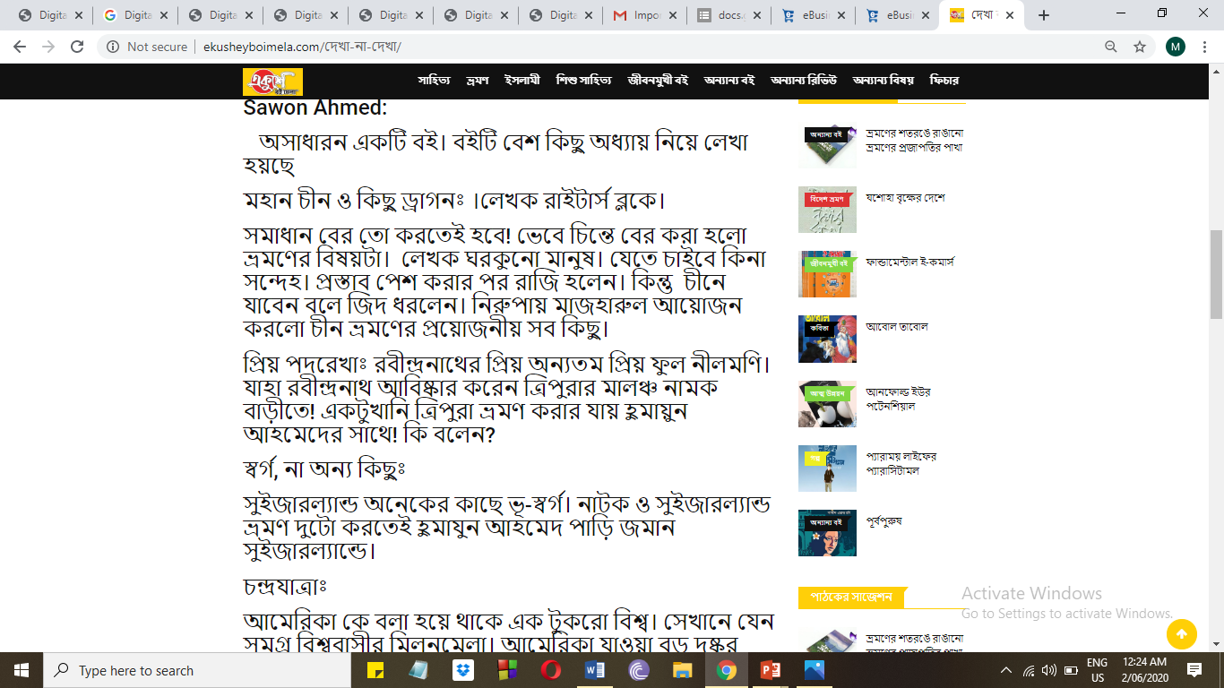
Content Development

Slide 25
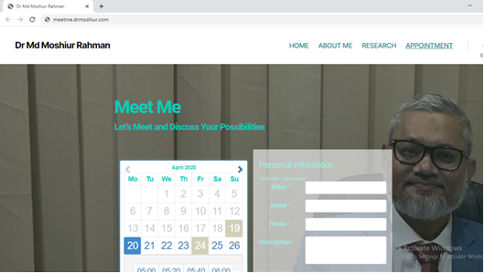
PROJECT (3) DR MD MOSHIUR RAHMAN
Font-end Designed

Slide 26


